Slide 1

Optimization of the Production of Function Antibodies to Discover Diagnostics and Therapeutics for Alzheimer’s Disease
Taylor Dolberg, Chemical Engineering
Arizona State University
Mentor: Dr. Michael Sierks, Professor- School for Engineering of Matter, Transport, and Energy (SEMTE)

Slide 2
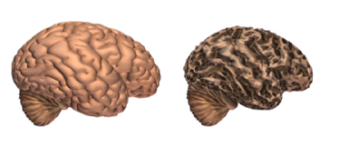
Introduction
Alzheimer’s Disease
A type of dementia, which causes memory, cognitive, and behavioral problems.
One of the top 10 leading causes of death in the US
5.4 million Americans
Affects ages 65+, early as 30-40
Costs the US $183 billion per year
Healthy Brain AD Brain
Figure 1: Alzheimer’s affect on the brain

Slide 3
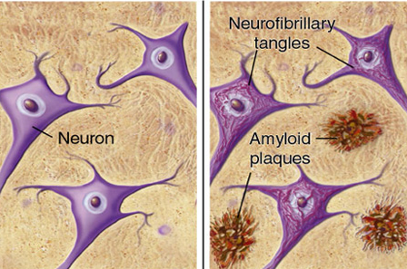
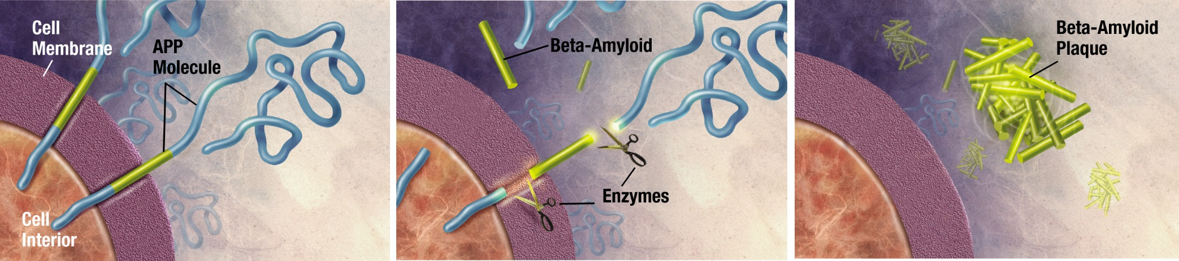
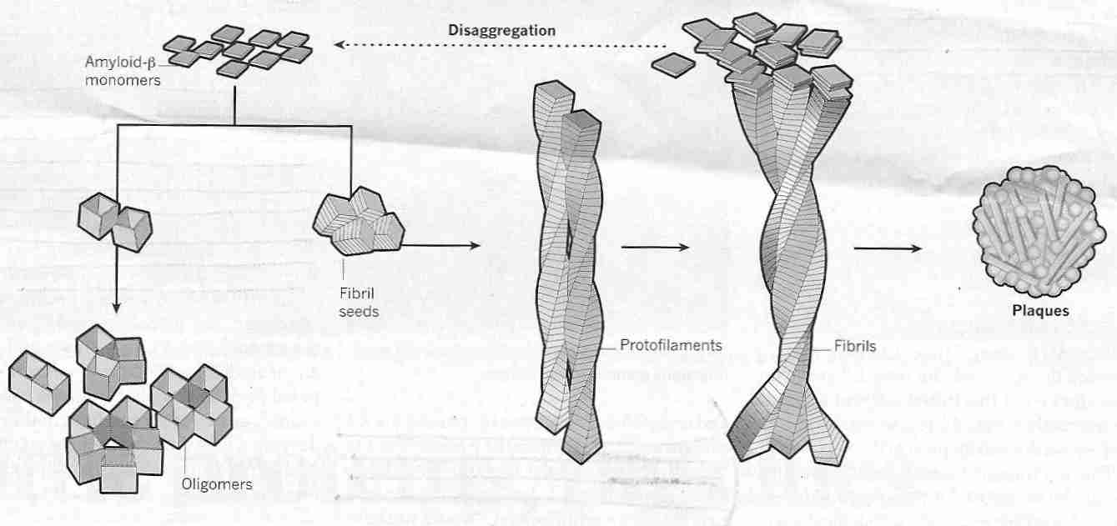
Protein Research Background
Beta-Amyloid (Aβ)
Alzheimer’s target protein
Formed by cleavage of APP by beta and gamma secretase
Starts as single protein, misfolds → oligomers and larger chains
Aβ fibrils and plaques = visual characteristic of AD
Antibodies that bind to different regions and sizes of Aβ may prevent progression into a more toxic stage
Figure 4: Healthy and AD neurons.
Figure 2: Formation of beta amyloid.
Figure 3: Aggregation of beta amyloid.

Slide 4
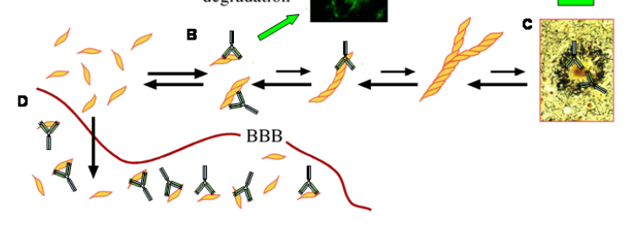
Protein Research Background
Create antibodies that bind to different forms of Aβ for a possible:
Therapeutic
Diagnostic
Early Detection
A: Bind to soluble Aβ to prevent further aggregation
B: Bind to Aβ plaques
C: Bind to Aβ in the periphery to draw it out of CNS.
A
C
B
Figure 5: Antibody binding to Aβ
Notes:
Therapeutic: if antibodies prevent AB from moving to a more toxic stage
Diagnostic: to study which form of AB is most toxic
Early Detection: bind to AB before cognitive symptoms are present
[A] Antibody binding to soluble AB forms (like oligomers) to prevent further aggregation
[B] Bind to AB plaques
[C] Bind to soluble AB in periphery, drawing AB out of the central nervous system

Slide 5
Approach
Goal: Best method to produce highest yield of functional antibody by modifying the growth conditions for E. Coli bacterial culture that express the antibody.
Variables
Growth Sugar Source (standard glucose)
[for more functional proteins]
Growth Optical Density (standard 0.8)
Sugar Source
0.5 M Mannitol (C₆H₁₄O₆) | 0.5 M Sorbitol (C₆H₁₄O₆)
0.4 M Glucose (C₆H₁₂O₆) | 0.4 M Sucrose (C₁₂H₂₂O₁₁)
Optical Density
OD = 0.5
OD = 1.0
Notes:
Mannitol and sorbitol are isomers (different orientation)
Sugars have hydrophobic regions which allow them to bind to hydrophobic sites on protein. For proteins to fold properly and be functional, various hydrophobic sites interact to fold the protein. If this is not done properly, the protein misfolds and aggregates.

Slide 6
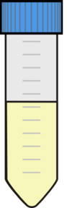
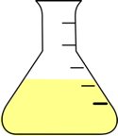
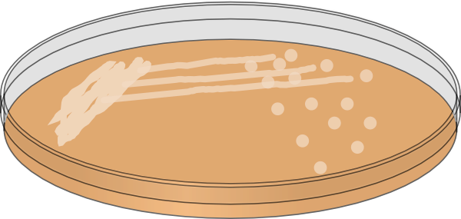
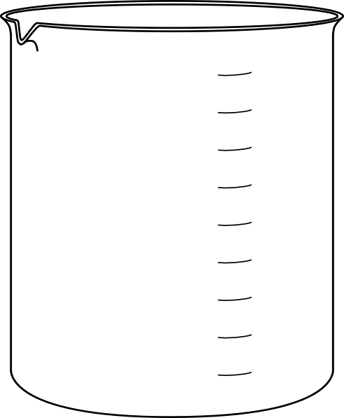
Method
Starter Culture
Periplasm
Pellet
Supernatant
Larger Culture
0.5M Mannitol Culture
PAGE and Western
Centrifuge
Dialysis
A4 Plate
BCA
BCA
Figure 6: Schematic of antibody production process.

Slide 7
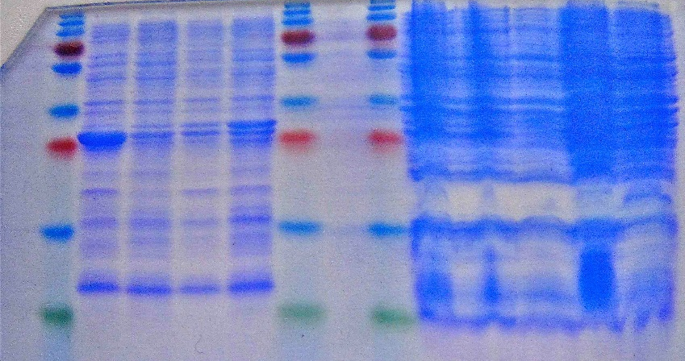
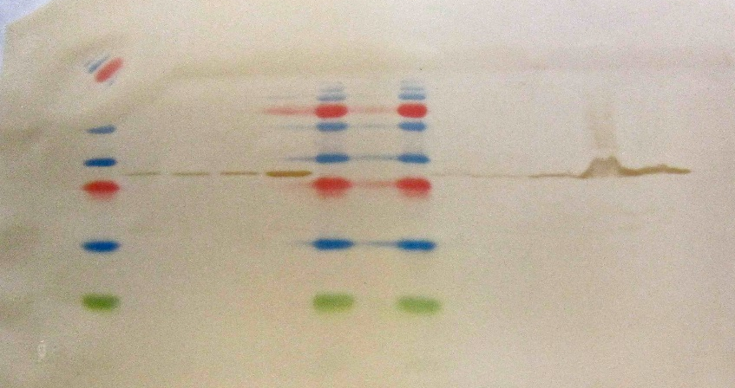
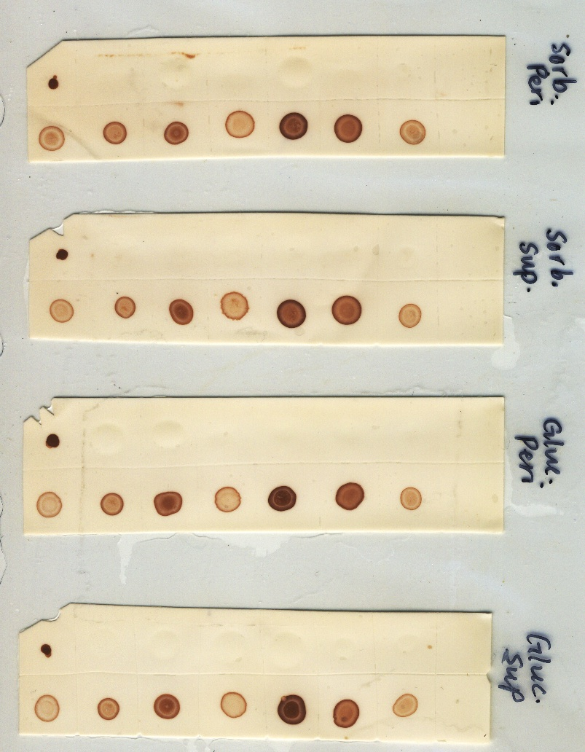
Results
1 2 3 4 5 6 7 8 9 10 11 12 13 14
1 2 3 4 5 6 7 8 9 10 11 12 13 14
Figure 7: PAGE gel for complex sugars.
Figure 8: Western for complex sugars.
 | Protein Concentration Before Dialysis (mg/mL) | Protein Concentration After Dialysis (mg/mL) | Percent Aggregation (%)
Sucrose | 0.671 | 0.506 | 24.59
Mannitol | 0.636 | 0.527 | 17.14
Sorbitol | 1.398 | 0.877 | 37.27
Glucose | 1.372 | 0.581 | 57.65
Figure 9: Sorbitol dot blot
Notes:
3 experiments (not all shown): surgars, OD, larger sorb vs. glucose control
1. α-PLB, 2. MW, 3. Peri-Man, 4. Peri-Sorb, 5. Peri-Gluc, 6. Peri-Suc, 7. MW, 8. α-PLB, 9. MW, 10. Pellet-Man, 11. Pellet-Man, 12. Pellet-Sorb, 13. Pellet-Gluc, 14. Pellet-Suc

Slide 8
Conclusion and Future
Sugar and Higher OD: beneficial to produce a large amount of the desired antibody.
Sorbitol and Mannitol: positively influence the protein concentration and do not suffer from too much protein loss or aggregation.
Larger Sorbitol Experiment: sorbitol increases concentration of protein.
Dot Blot: shows protein functionality because the proteins bind to transgenic tissue.
Future
ELISA Assay: Use antibodies to detect overexpression of Aβ oligomers in mice samples compared to a control.
Biomarkers for Alzheimer’s Disease hopefully!

Slide 9


Acknowledgments
Thank You!
Questions?
Thank you to the ASU NASA Space Grant Program, and all of the people who make it work, for making my research possible. Thank you to my mentor, Dr. Michael Sierks for the opportunity to work in his lab. Thank you to the lab manager, Phil, and all of the graduate students and post docs in the lab who have helped me along the way!

Slide 10
References
http://www.benbest.com/lifeext/Alzheimer.html
http://en.wikipedia.org/wiki/Biochemistry_of_Alzheimer's_disease
http://commons.wikimedia.org/wiki/File:Amyloid-plaque_formation-big.jpg
http://www.brightfocus.org/alzheimers/about/understanding/plaques-and-tangles.html
http://homepages.rpi.edu/~tessip/Tessier_lab/Research.html
http://www.discoverymedicine.com/Kevin-A-Dasilva/2009/07/12/new-therapeutic-approaches-for-alzheimers-disease/

